Slide 1
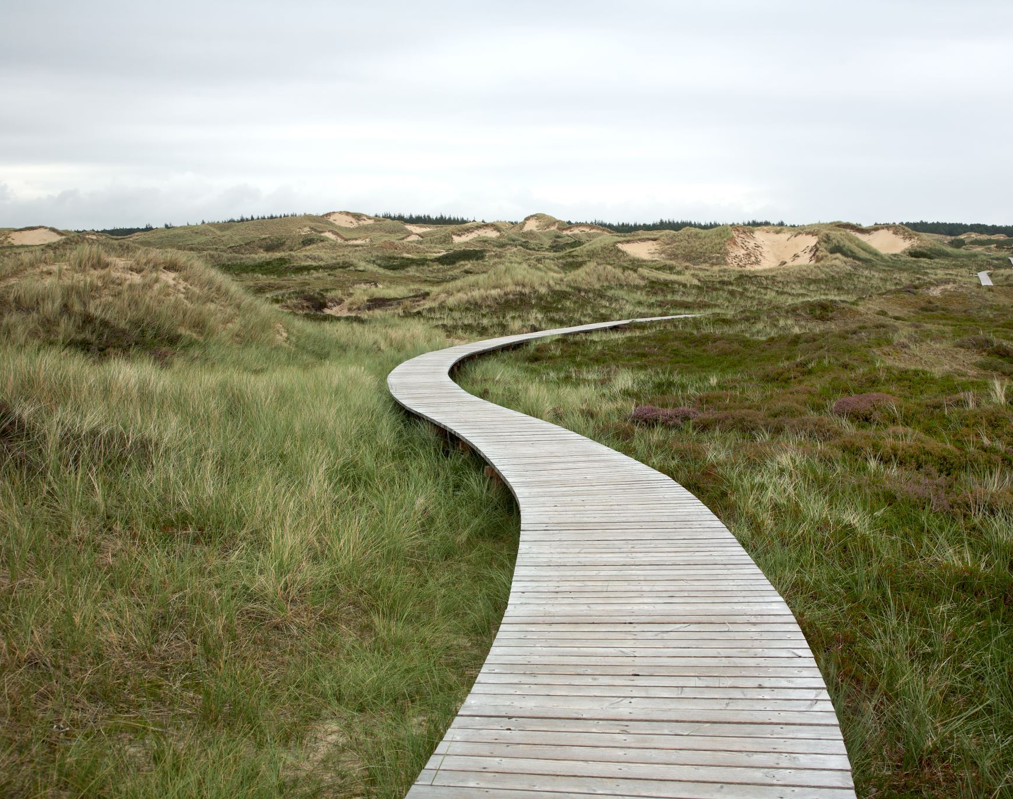
Cloud Adoption Framework
Overview
Part 2 – Landing Zones

Slide 2
Agenda
Build a landing zone that supports your goals
What is a landing zone?
What do we cover in the landing zone?
How do we think about governance?
What are the tools that support governance?

Slide 3


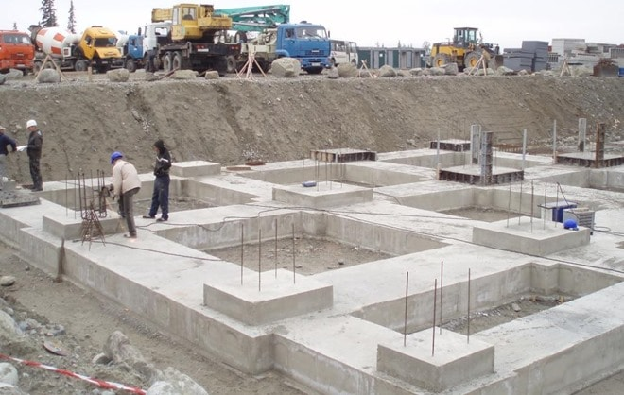
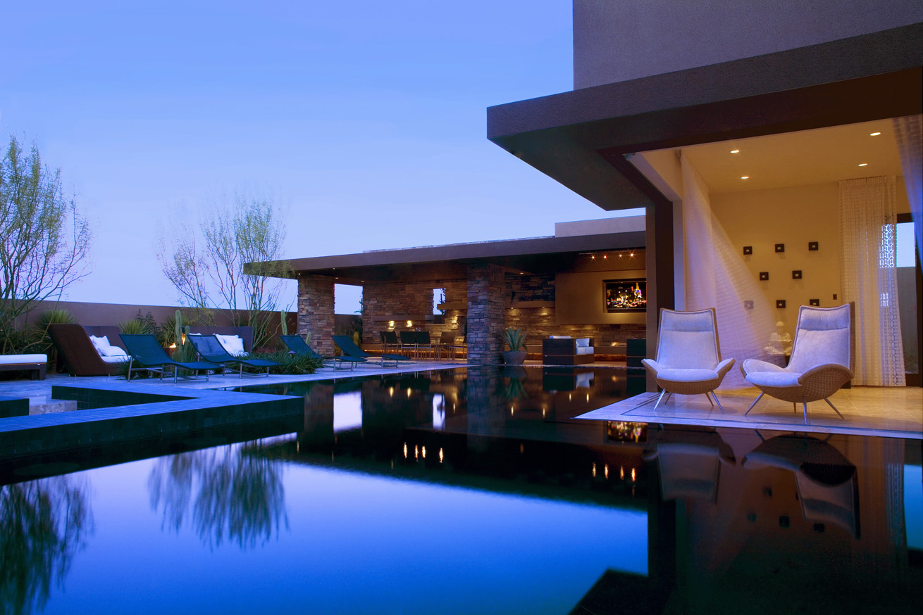
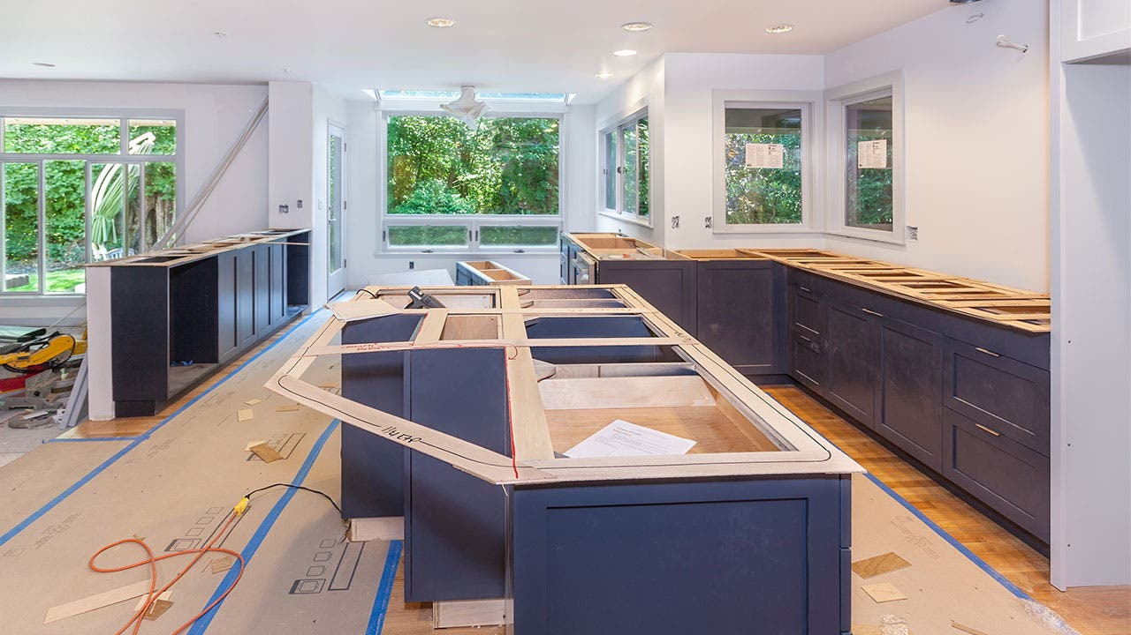
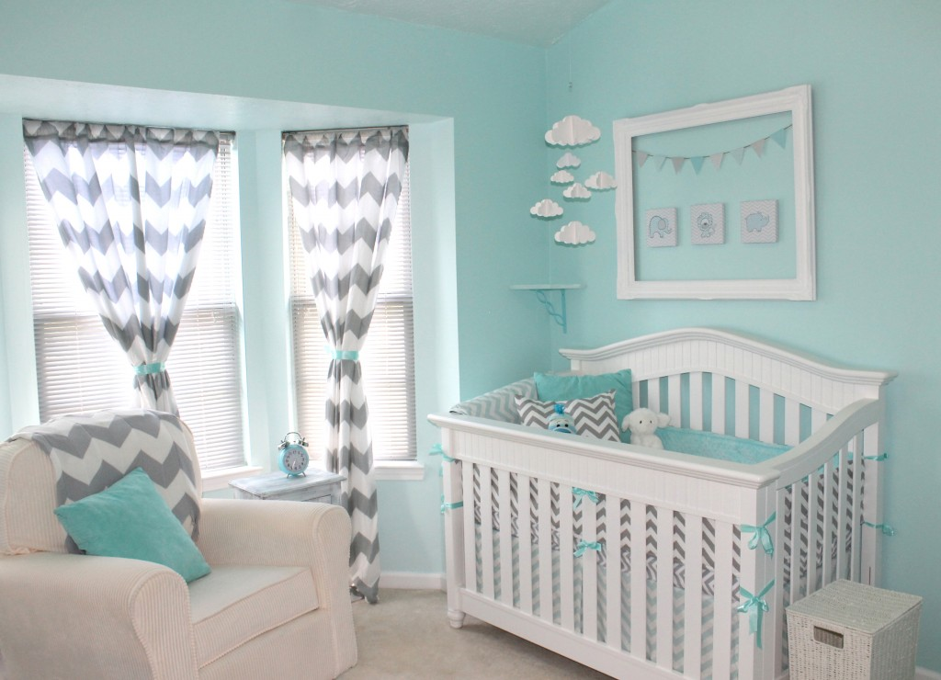
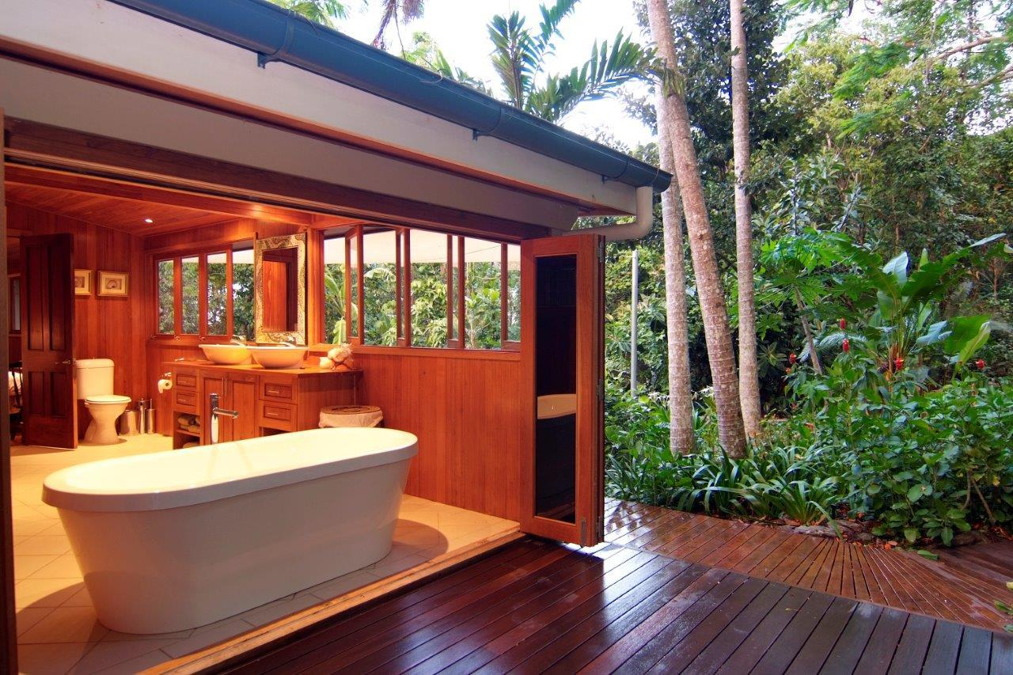
The phases to livability – building your home
I need a home
Build a plan
Start my build
Decision criteria:
Where?
What does it need?
Cost / taxes?
Growth?
Environment?
Proximity to services?
Lifestyle
My plan:
Number of rooms
House direction
Features / luxuries?
What can I afford today?
My build:
Contractor
Foundation
Services
Inspection
My house:
Built to plan
With what I need today?
“Life changes and evolves”
Add new features
Extension
Holiday home

Slide 4
Azure
I need a CLOUD
Build a plan
Landing zone
Decision criteria:
Who?
Cost?
Capabilities?
Relationship?
My plan:
Motivations
Horizons
Business Requirements
Skills
Backlog of work / projects
My build:
Connectivity
Security
Management
Business Continuity
My environment:
Workloads
Services
Applications
“Business changes and evolves”
Add new capabilities
Expand Portfolio
M&A / Growth

Slide 5
Microsoft Cloud Adoption Framework
Business
Platform
Workload
Define strategy
Understand motivations
Business outcomes
Business justification
Prioritize project
Adopt
Ready
Azure readiness guide
First landing zone
Expand the blueprint
Best practice Validation
Migrate
• First workload migration
• Expanded scenarios
• Best practice validation
• Process improvements
Manage
Business commitments
operations baseline • Ops maturity
Innovate
• Innovation guide
• Expanded scenarios
• Best practice validation
• Process improvements
Plan
Digital estate
Initial organization alignment
Skills readiness plan
Cloud adoption plan
Govern
Methodology • Benchmark
initial best practice • Governance maturity
Well-Architected
Operational Excellence | Performance Efficiency | Reliability | Security | Cost Optimization
Notes:
This slide is intended to set the direction for CAF and showing the intersect with Well-Architected.
The next slide is an example of how we talk to Governance..

Slide 6
Enterprise-scale?
Enterprise-scale is an architecture approach and reference implementation that enables effective construction and operationalization of landing zones on Azure, at scale and aligned with Azure Roadmap and Microsoft Cloud Adoption Framework for Azure.
Authoritative Provides holistic design decision framework for Azure Platform.
Proven
Based on success of large-scale migration projects at-scale.
Prescriptive Apply this on "Monday Morning" in your Azure environment.
Enterprise-scale Architecture:
Enterprise-scale design principles: Principles to help/guide you customize the design.
Enterprise-scale design guidelines: Guidelines (decisions and recommendations) for the 8 components of the enterprise-scale architecture
Enterprise-scale Implementation guide: The way you create those things using reference implementation in GitHub and the deployment pipeline
Enterprise-scale Reference Implementation:
Enterprise-scale foundation: A reference implementation of shared services containing network, security, identity, governance services required to construct and operationalize an enterprise-scale landing zone
Enterprise-scale landing zone(s): A reference implementation of a workload environment conforming to the enterprise-scale architecture (opinionated way to implement, code)
Notes:
Enterprise-scale comes in two buckets
The Architecture – What must be true? This is our Microsoft opinion on what should be done based on really world work with our strategic customers.
The reference implementation – This is a first partner example on how this could be implemented. You do not have to use this reference implementation if you are following the design guidelines and principles.
In the rest of the session, we’ll discuss these 5 elements.

Slide 7
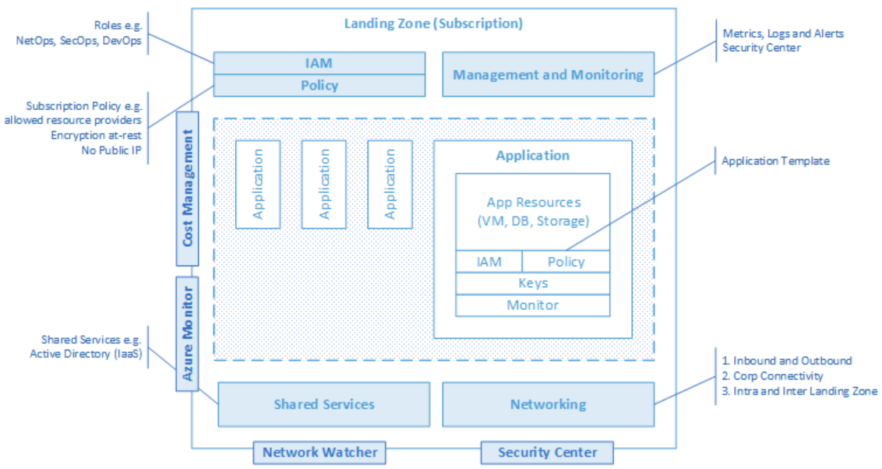
Enterprise-scale landing zone(s) The principle purpose of the “Landing Zone” is therefore to ensure that when an application or workload lands on Azure, the required “plumbing” is already in place, providing greater agility and compliance with enterprise security and governance requirements.

Slide 8
Enterprise-scale Design Principles
Subscription Democratisation
Policy Driven Governance
Single Control and Management Plane
Application Centric and Archetype-Neutral
Azure Native Design and Platform Roadmap Alignment
Enable Autonomy for Innovation and Transformation
Security and Compliance By-Default
Governance At-Scale with Sustainable Cloud Engineering
Notes:
Subscriptions should be used as a unit of management and scale aligned with business needs and priorities.
Azure Policy should be used to provide the “guard-rails” and ensure the continued compliance of the customer platform and applications deployed onto it, whilst also providing application owners sufficient freedom and a secure unhindered path to cloud.
The “North Star” architecture should not consider any abstraction layers such as customer developed portals or tooling and should provide a consistent experience for both AppOps (centrally managed operation teams) and DevOps (dedicated application operation teams).
The “North Star” architecture should focus on application centric migrations and development rather than a pure infrastructure “lift and shift” migration (i.e. movement of virtual machines) and should not differentiate between old/new applications or IaaS/PaaS applications.
The North Star architecture strongly advocates the use of native platform services and capabilities wherever possible, which should be fully aligned with Azure platform roadmaps from the offset to ensure new capabilities are swiftly made available within customer environments.

Slide 9
Show n’ Tell
Enterprise-Scale in the Cloud Adoption Framework
Azure Policy
Azure Blueprints
Azure Cost Management

Slide 10
References
http://aka.ms/adopt
http://aka.ms/adopt/plan/generator
http://aka.ms/enterprisescale - reference implementation
http://aka.ms/enterprise-scale - Adoption Framework content
http://docs.Microsoft.com/learn - Enterprise-scale learning path

Slide 11
Thank you !!!

